Slide 1

Facilities Update
Presented to:
Garden Grove Unified School District
Bond Oversight Committee
September 12, 2017
Presenters: Margaret Brown and Jerry Hills

Slide 2
Overview
  Modernization and HVAC
  HVAC
  Seismic Replacement
  Stadium Renovation
  Projects in Planning

Slide 3
Modernization & HVAC
    Ralston
    Bolsa Grande
    Los Amigos
    Santiago
    Garden Grove(Don Wash Auditorium)

Slide 4
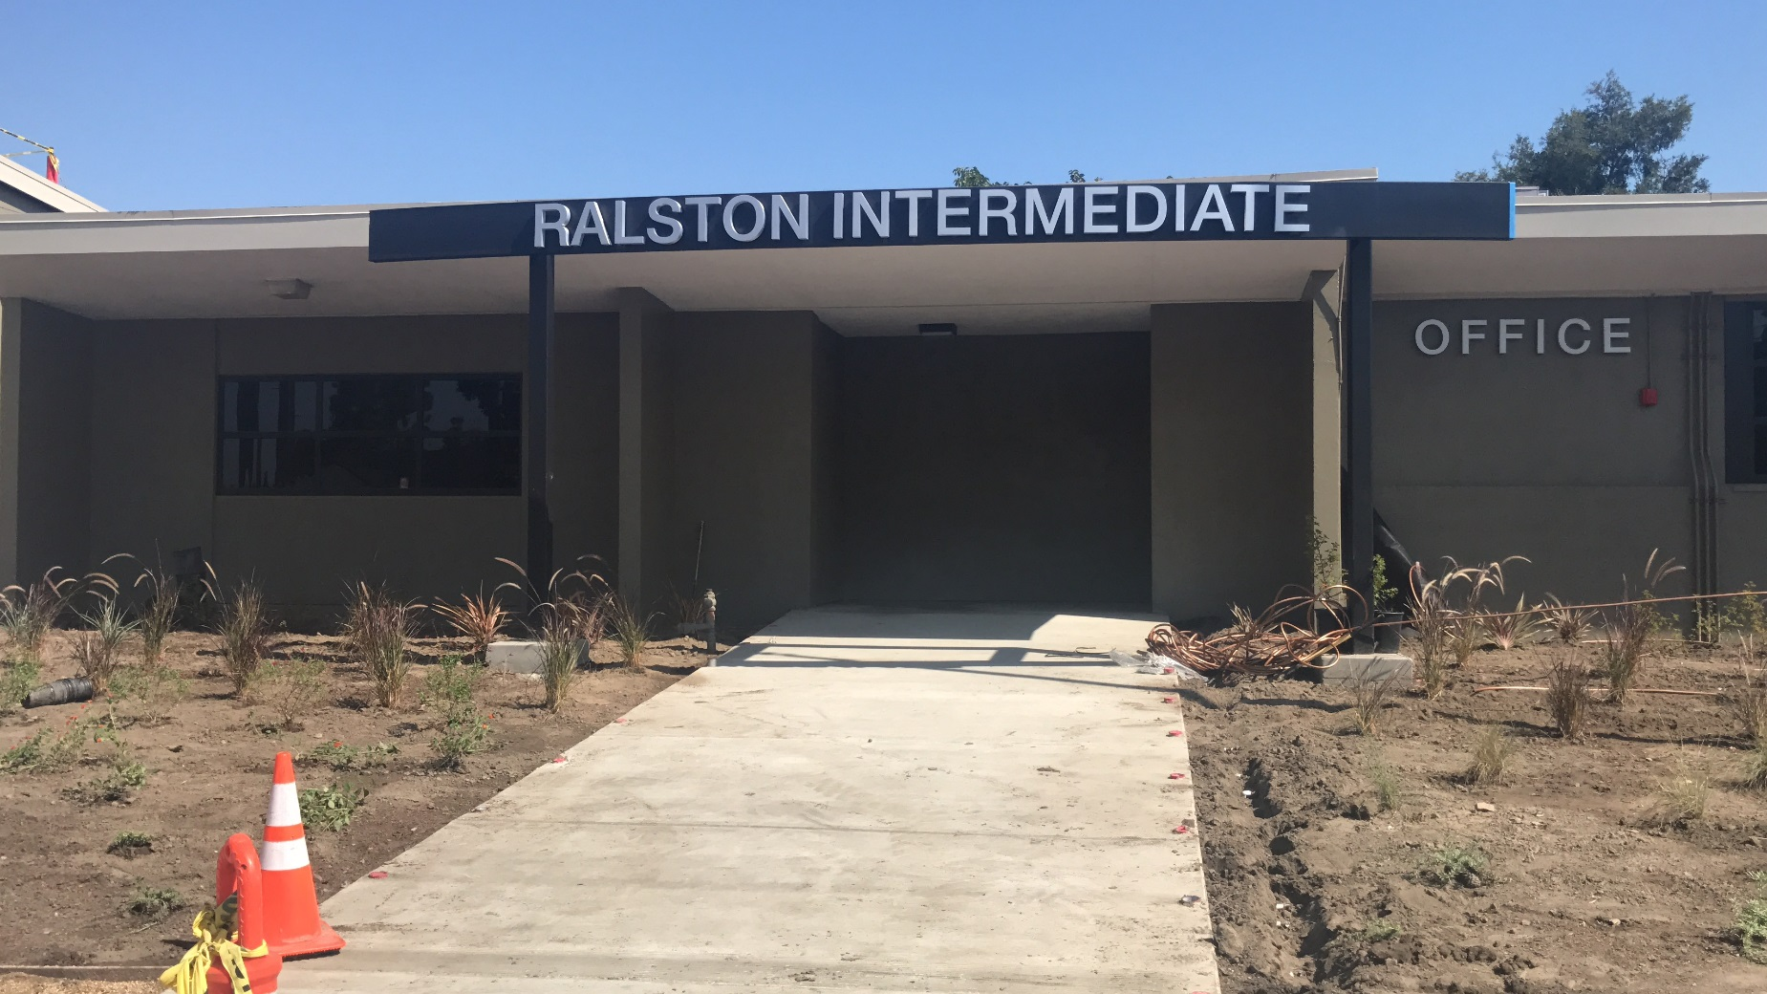
Modernization & HVAC
Ralston IS
Relocated office entry and added classroom space

Slide 5
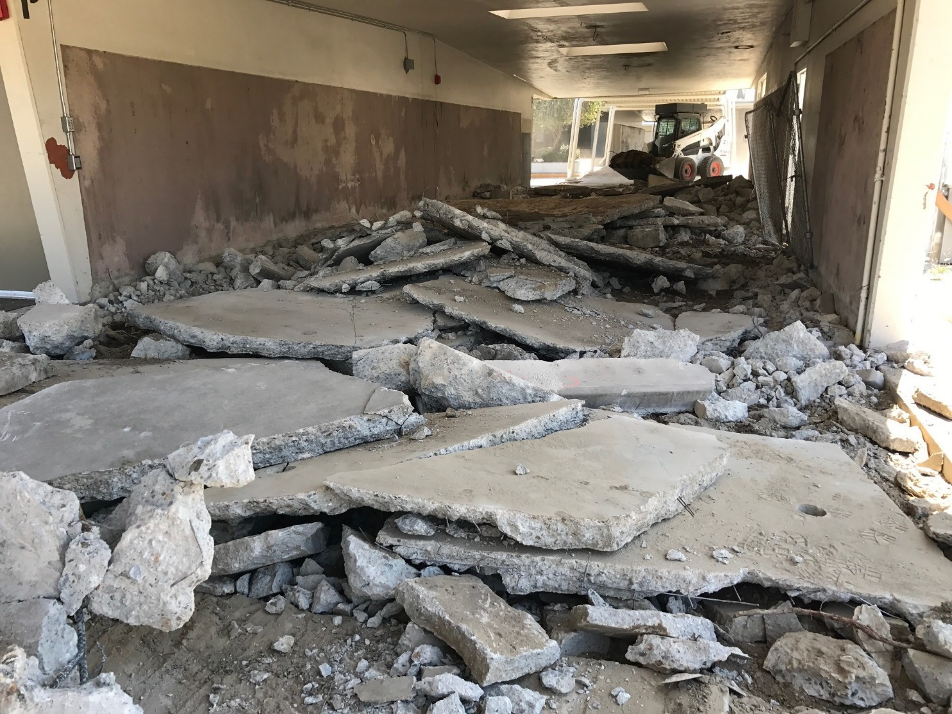
Modernization & HVAC
Bolsa Grande HS
Concrete removal for ADA path of travel

Slide 6
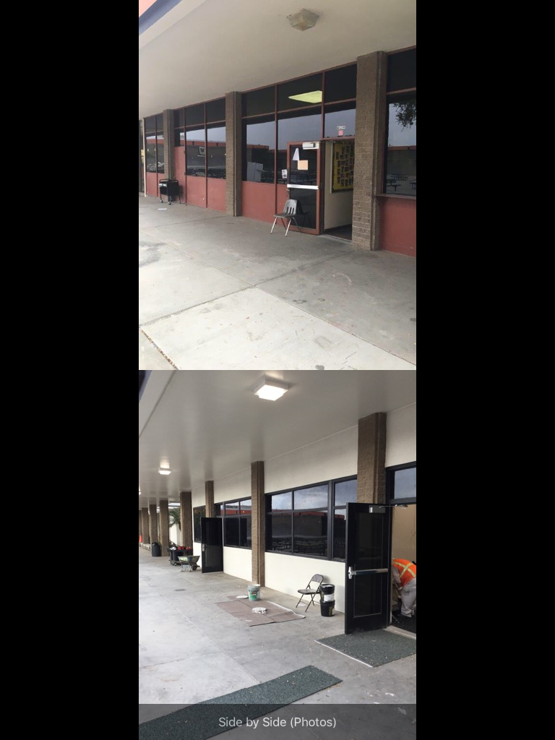
Modernization & HVAC
Los Amigos HS
Before
After
Accessible doors, Energy efficient windows and lighting

Slide 7
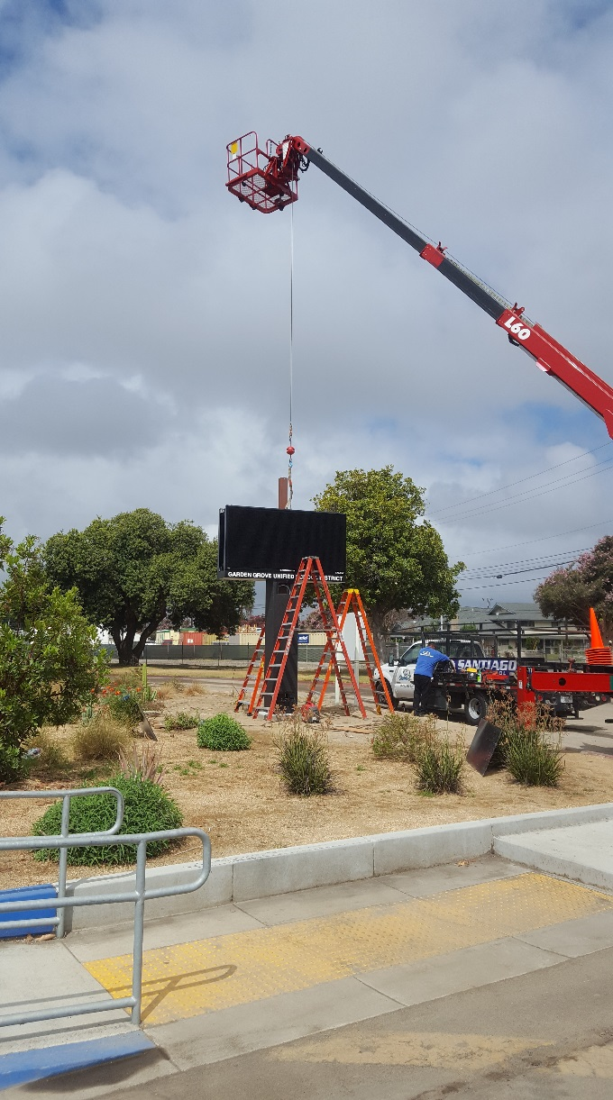
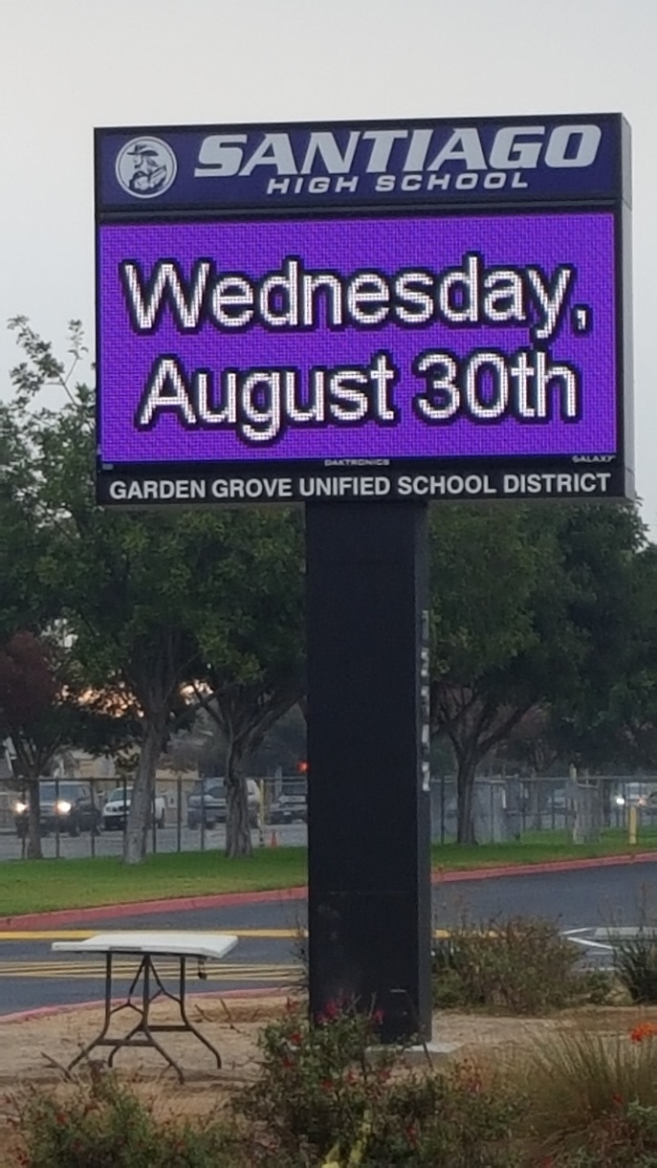
Modernization & HVAC
Santiago HS
New Marquee

Slide 8
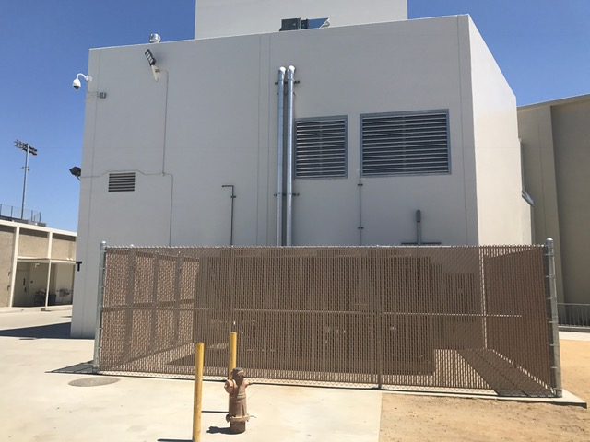
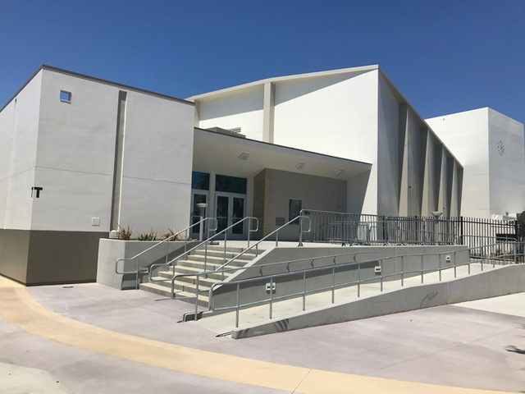
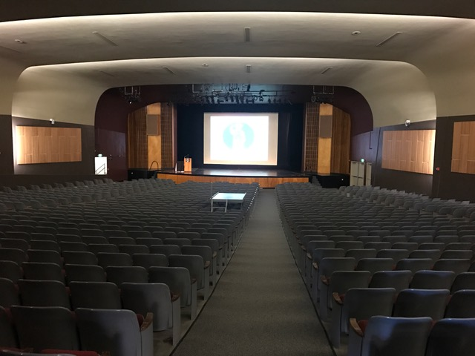
Modernization & HVAC
Garden Grove HS
(Don Wash Auditorium)
Chiller Enclosure
Accessible Entry
Theater Renovation

Slide 9
PACIFICA/LA QUINTA HIGH SCHOOL
Seismic Replacement
LA QUINTA HS Replacement Buildings
Phase 1 CR Construction – Summer 2016
Move In / Exis. Building Demo – Summer 2017
Phase 2 CR & Cafeteria Const. – Winter 2017
Move In / Exis. Building Demo – Winter 2018
Theatre & Library Media – Winter 2018
Completion – Fall 2019

Slide 10
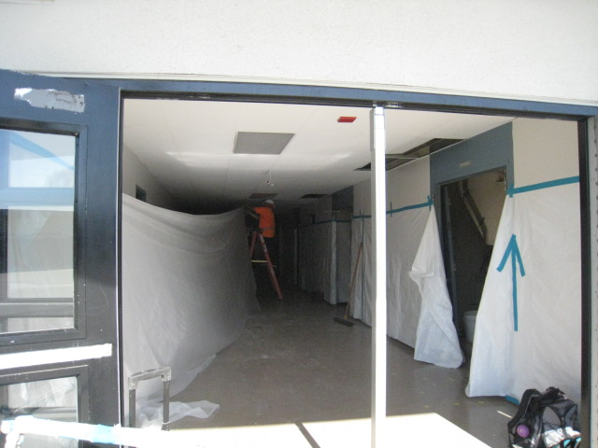
Seismic Replacement
Pacifica HS
Phase 2: Abatement Begins

Slide 11
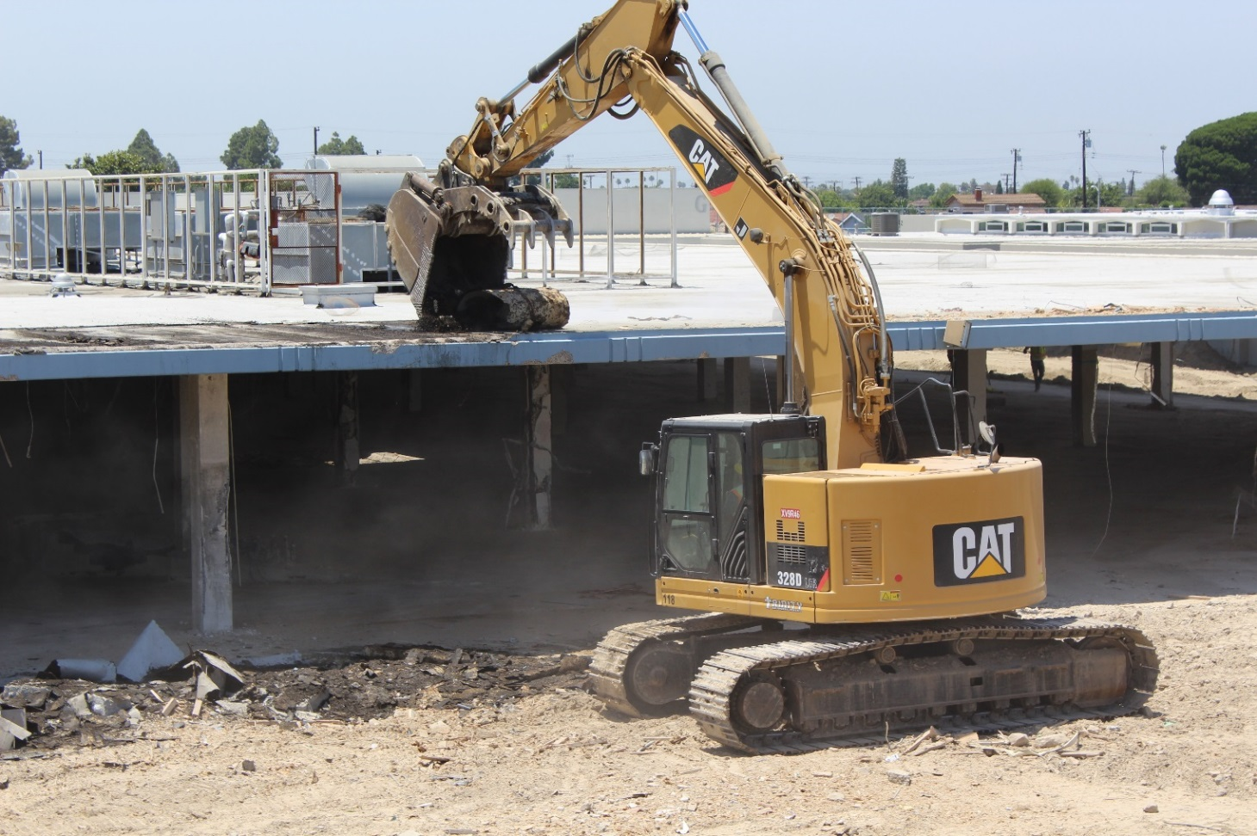
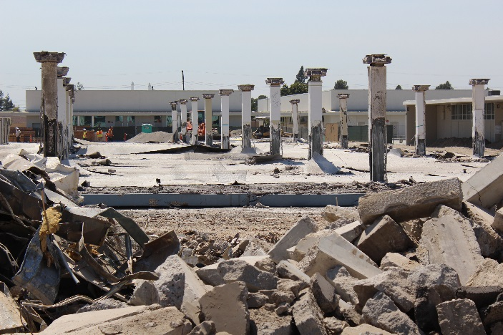
Seismic Replacement
Pacifica HS
Phase 2: Demolition

Slide 12
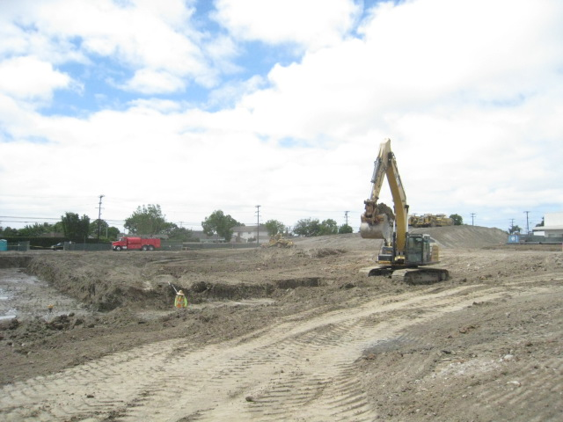
Seismic Replacement
Pacifica HS
Phase 2: Over Excavation and Grading

Slide 13
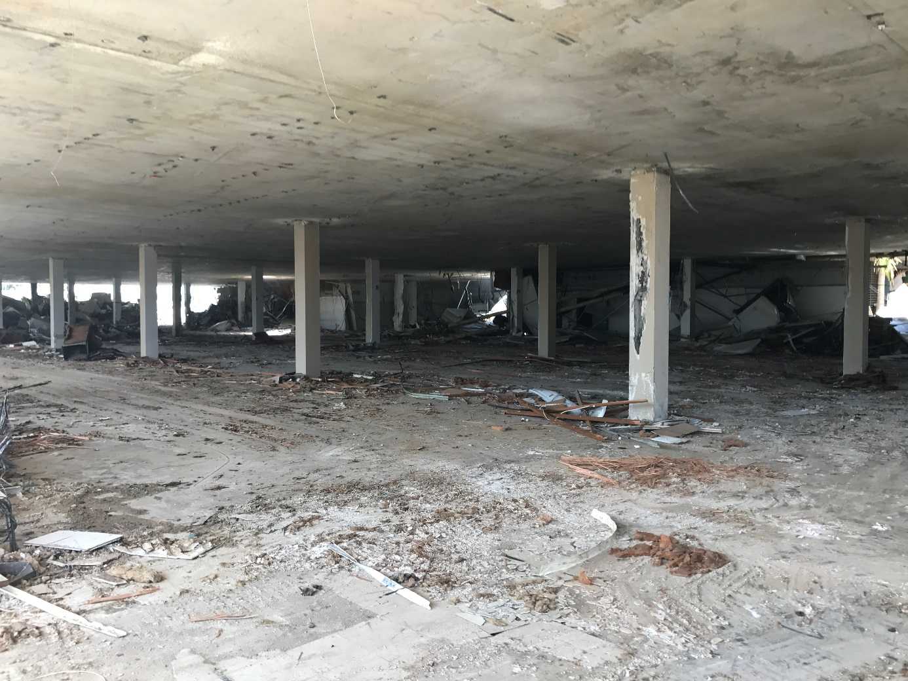
Seismic Replacement
La Quinta HS
Building Interior Demo

Slide 14
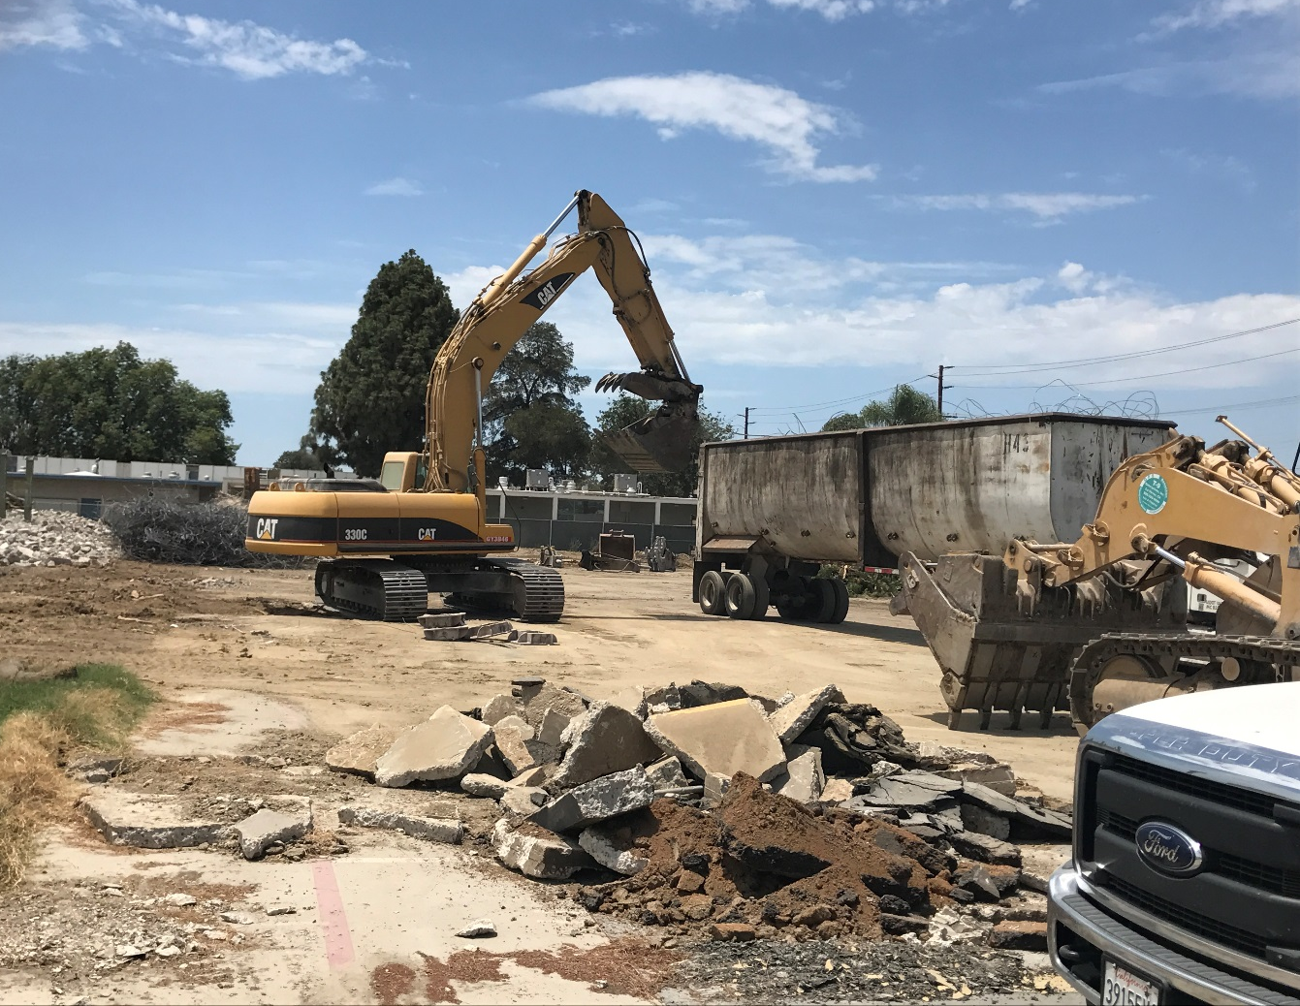
Seismic Replacement
La Quinta HS
Removing Demo Debris from the Site

Slide 15
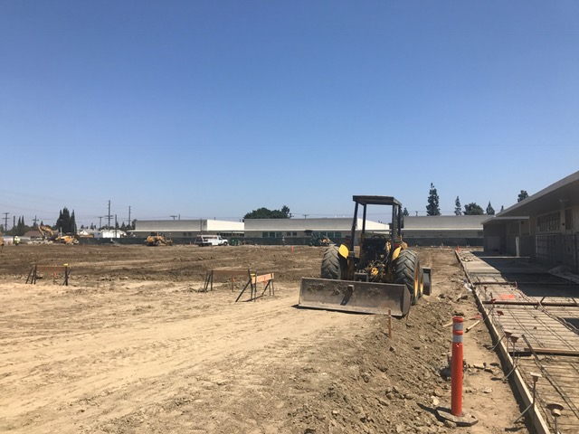
Seismic Replacement
La Quinta HS
Grading for Building Pads

Slide 16
HVAC projects Summer 2017
  Hazard ES
  Heritage ES
  Rosita ES
  Wakeham ES
  Zeyen ES

Slide 17
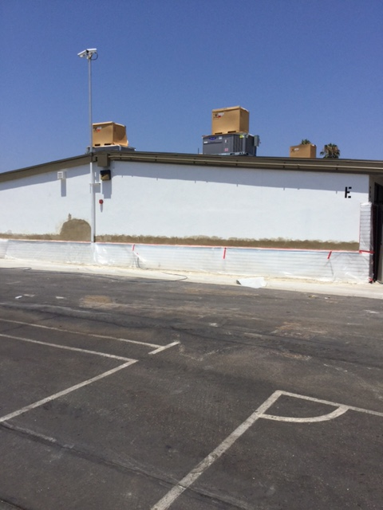
HVAC
Hazard ES
Preparation for Paint, HVAC units being installed

Slide 18
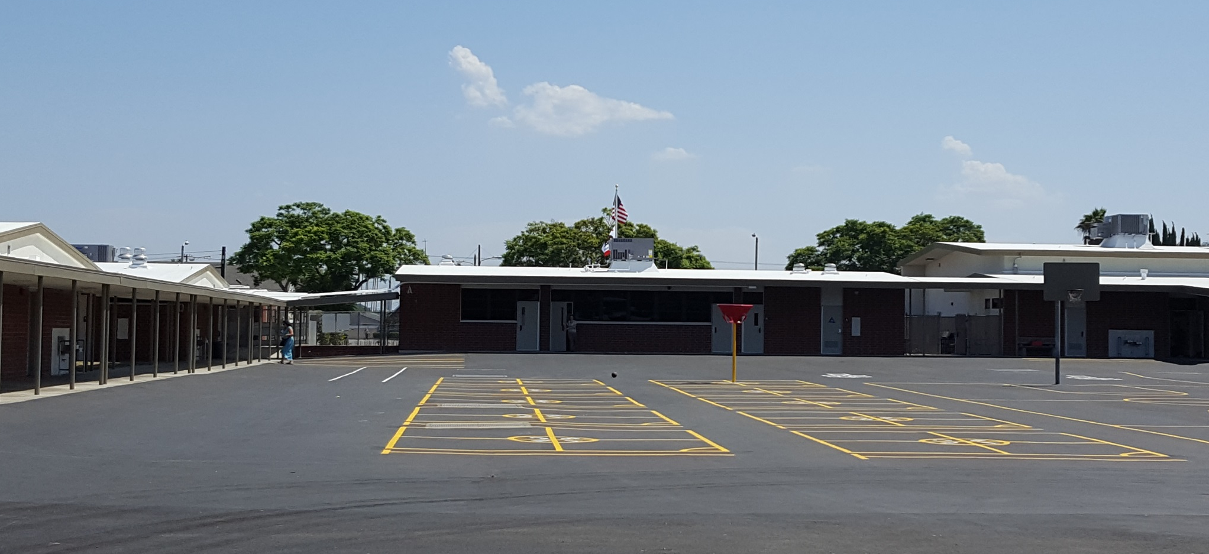
HVAC
Heritage ES
Windows, Roofing, HVAC, Asphalt

Slide 19
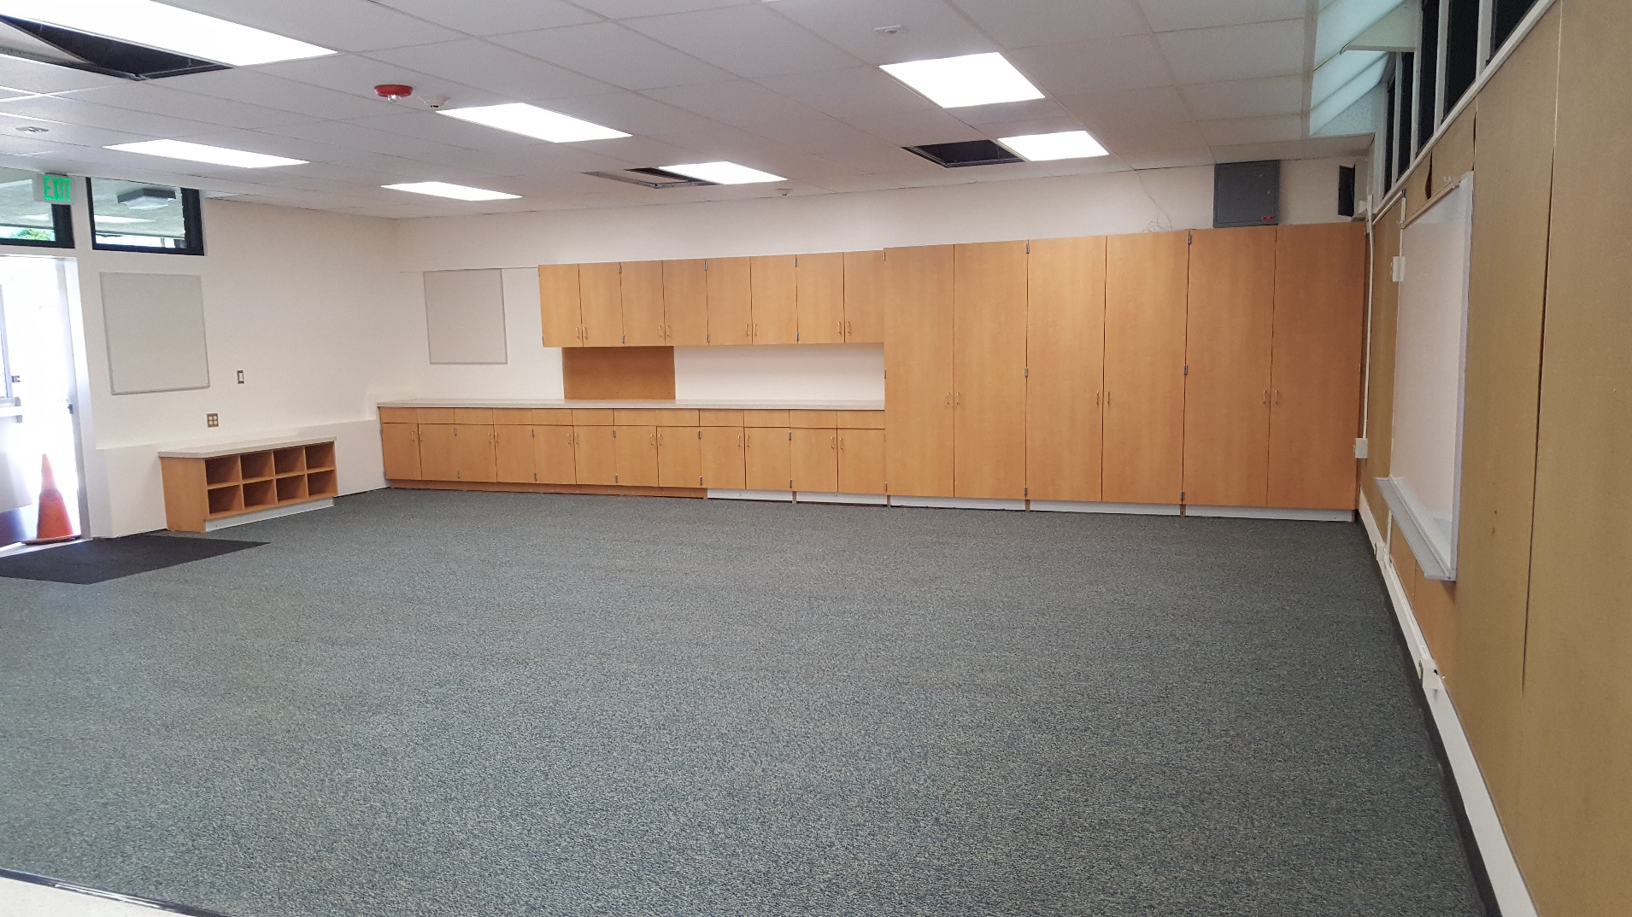
HVAC
Rosita ES
New Classroom Casework, Windows, Lighting, & Dropped Ceiling

Slide 20
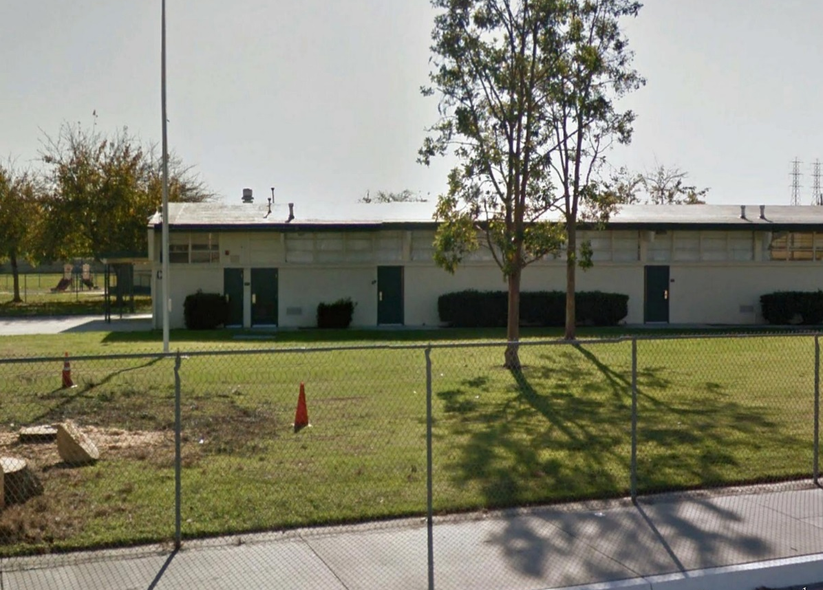
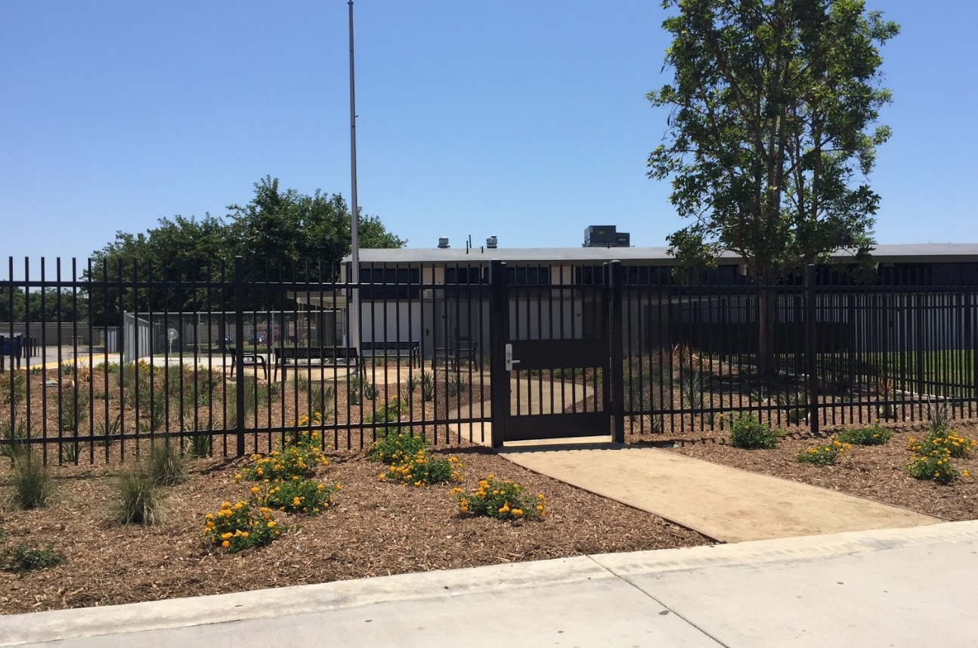
HVAC
Wakeham ES
Before
After
New Office Location and Secure Entry

Slide 21
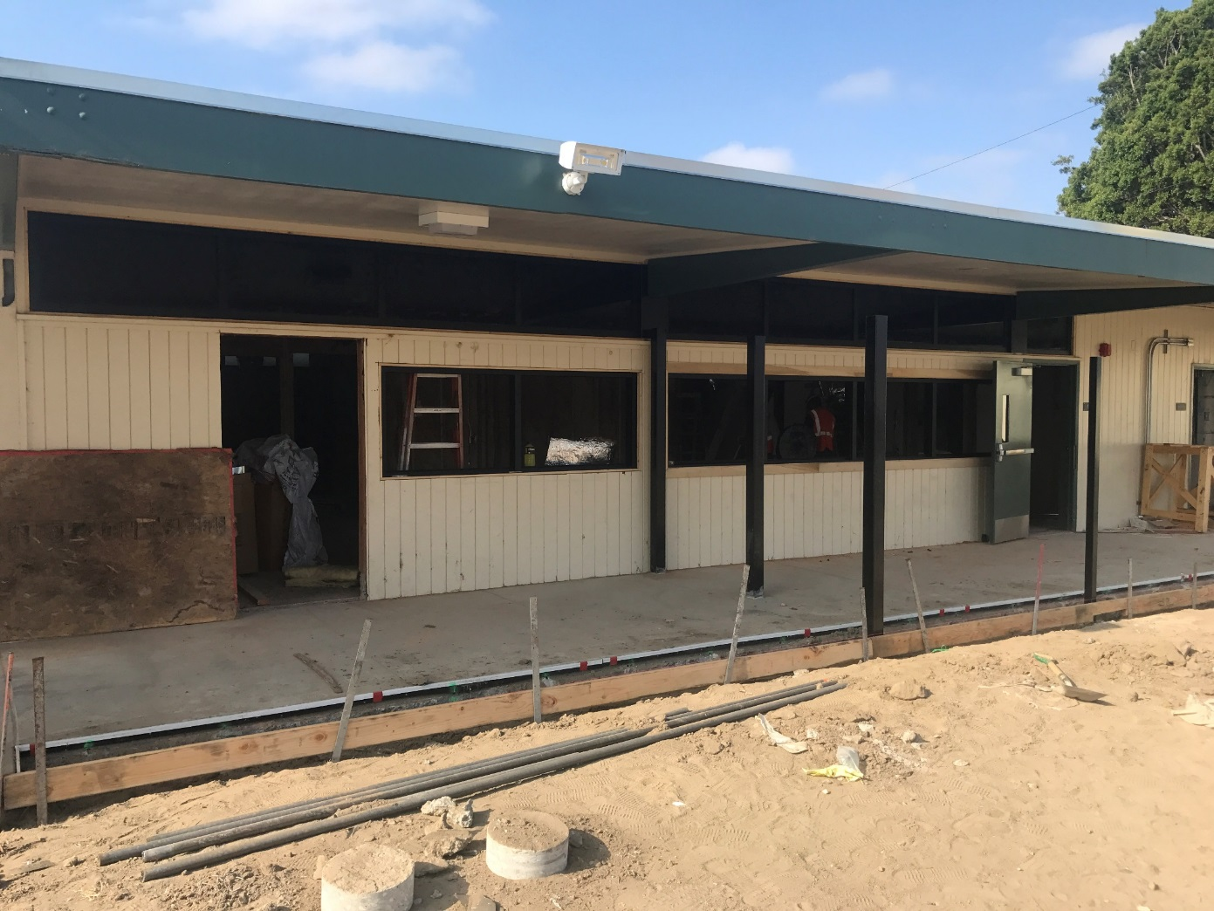
HVAC
Zeyen ES
Preparing for New, Secure Office Location

Slide 22
Stadium Renovation
Michael A. Monsoor
Memorial Stadium

Slide 23
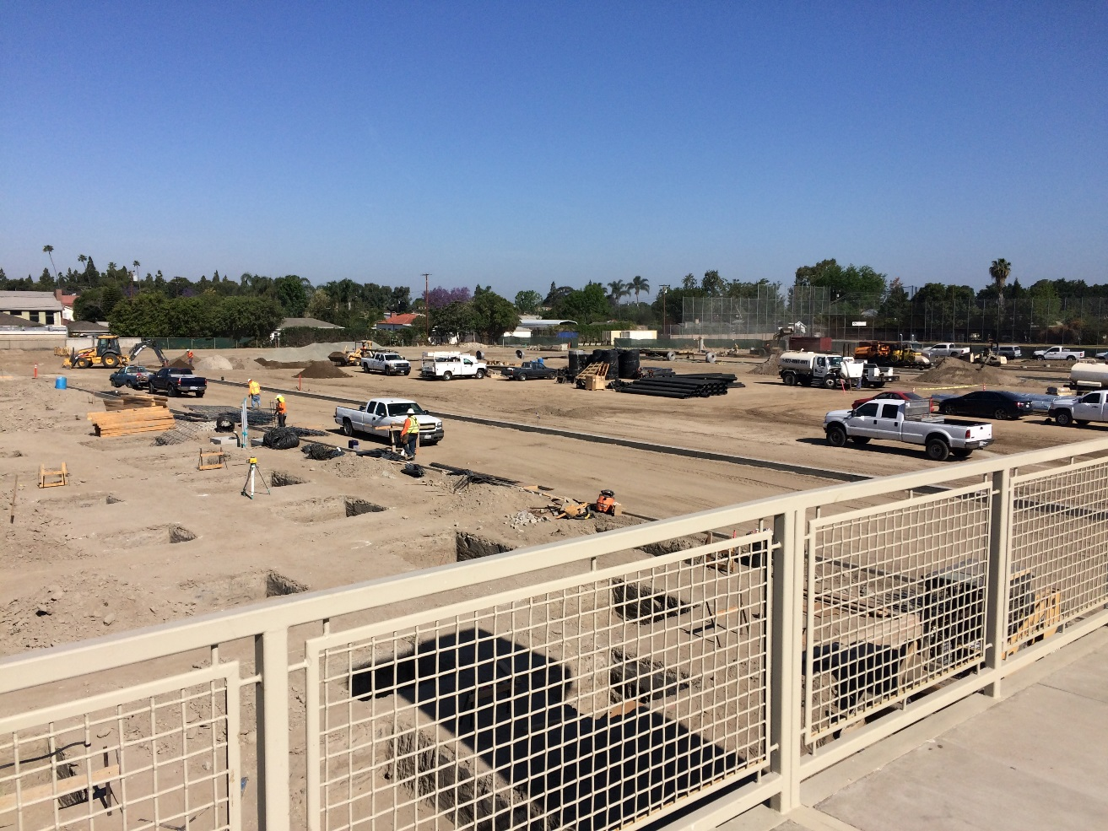
Monsoor Stadium
Garden Grove HS
Bleacher footing excavation

Slide 24
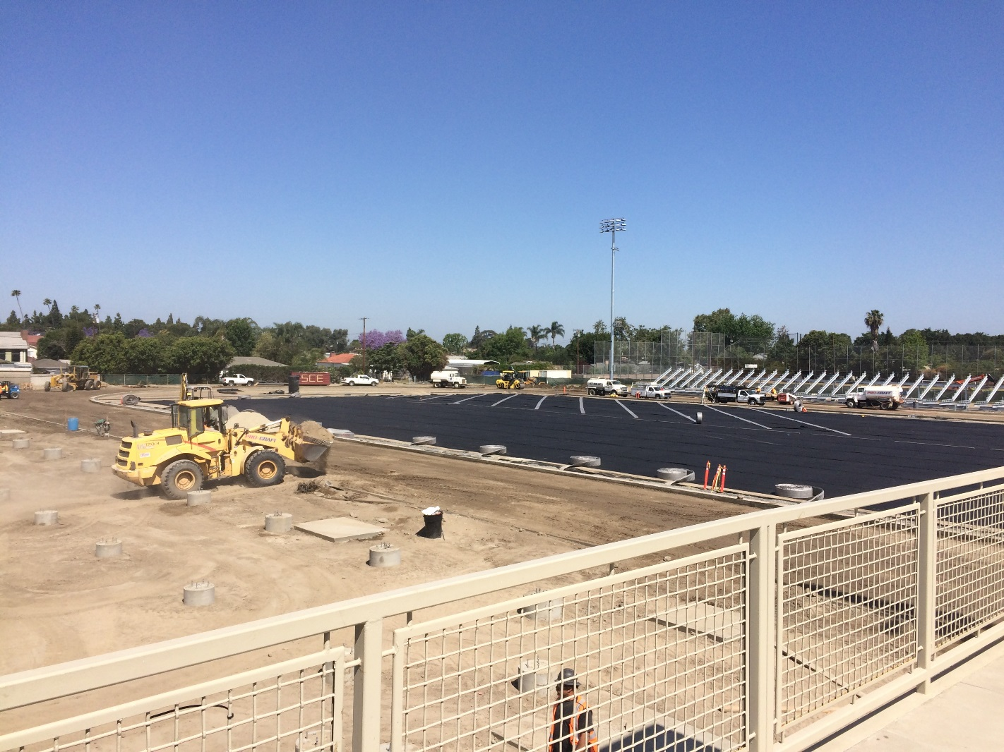
Monsoor Stadium
Garden Grove HS
Under Field Drainage

Slide 25
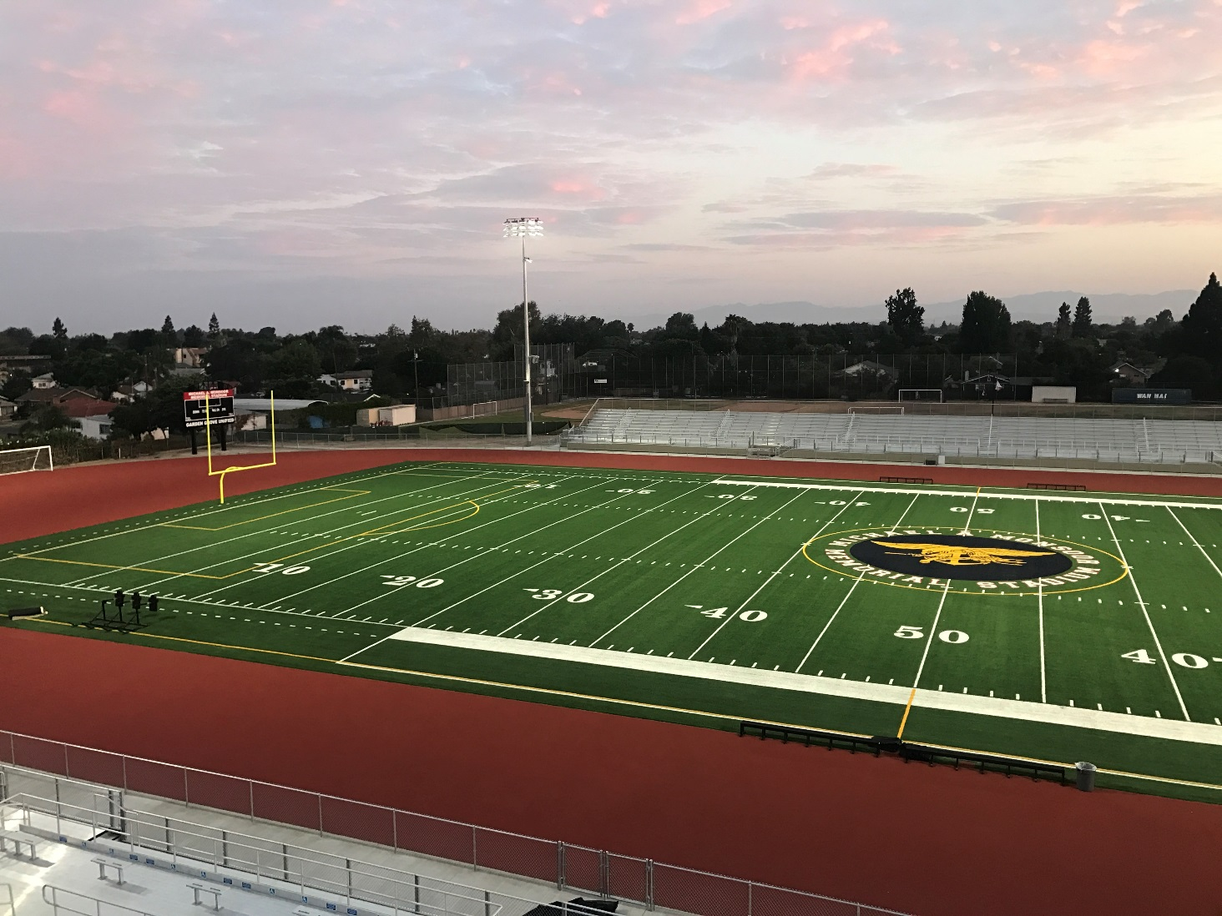
Monsoor Stadium
Garden Grove HS
Game ready

Slide 26
Other projects in planning
HVAC projects 2018 and beyond
Bolsa Building R
Bolsa Stadium
Seismic Gym Locker Buildings

Slide 27
QUESTIONS

Slide 28
Facilities Update
Thank You!

