Slide 1

Facilities Update
Presented to:
Garden Grove Unified School District
Bond Oversight Committee
January 9, 2018
Presenters: Margaret Brown and Jerry Hills

Slide 2
Overview
  Modernization and HVAC
  HVAC
  Seismic Replacement
  Projects in Planning

Slide 3

Modernization & HVAC
    Ralston
    Bolsa Grande
    Los Amigos
    Santiago

Slide 4
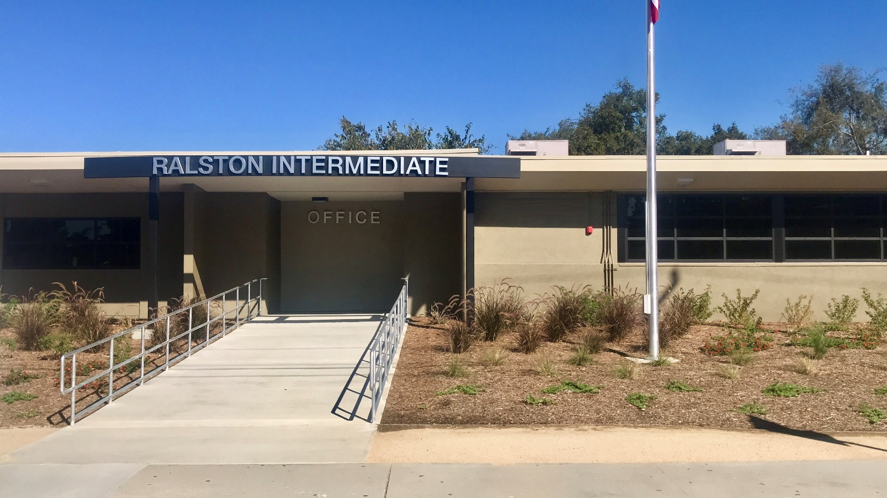
Modernization & HVAC
Ralston IS
Relocated office entry for increased security and added classroom space

Slide 5
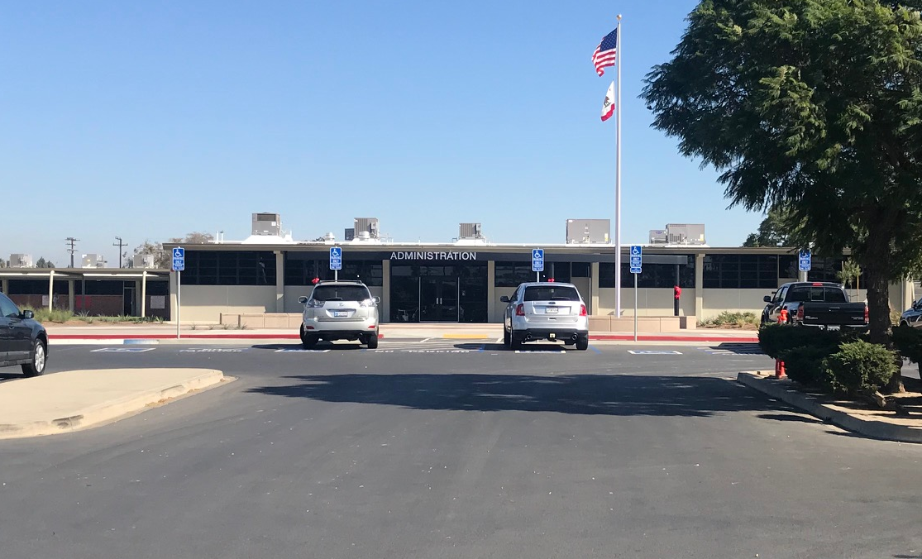
Modernization & HVAC
Bolsa Grande HS
More usable office space, efficient windows, new flagpole, HVAC units

Slide 6
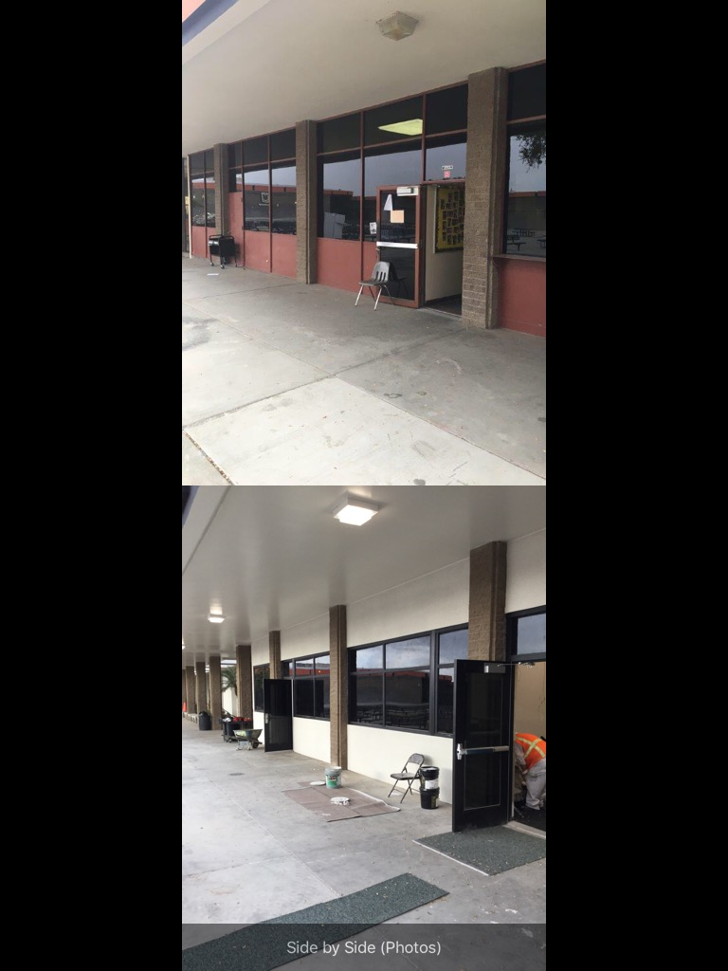
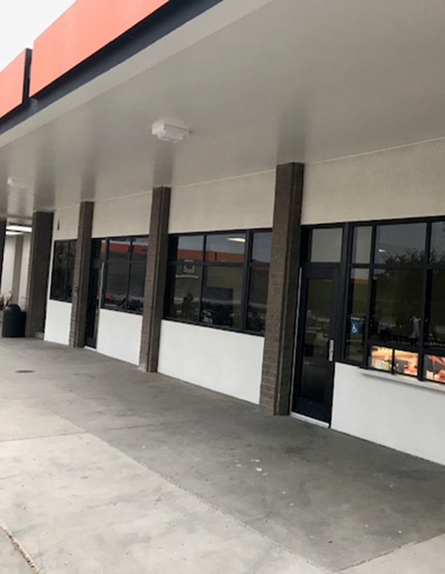
Modernization & HVAC
Los Amigos HS
Before and After - Admin offices looking from quad
New accessible doors, energy efficient windows and lighting

Slide 7
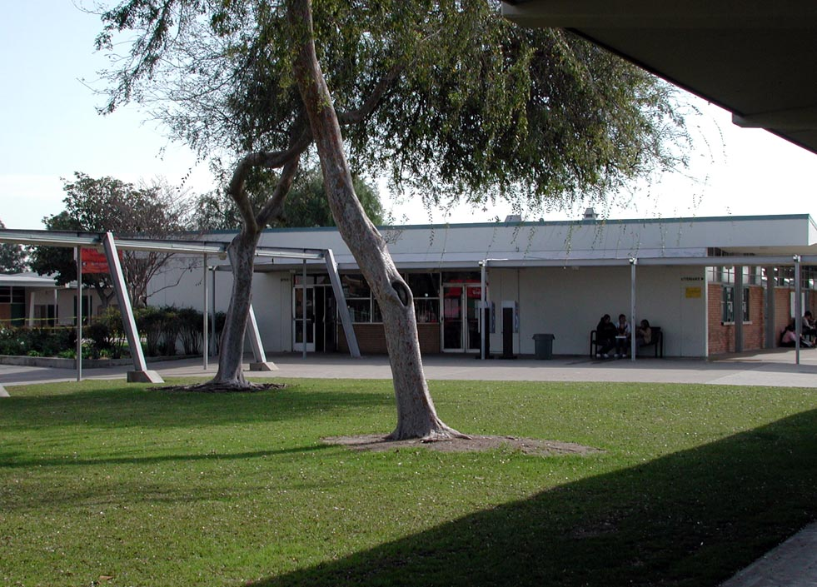
Modernization & HVAC
Santiago HS
Before - Front of school

Slide 8
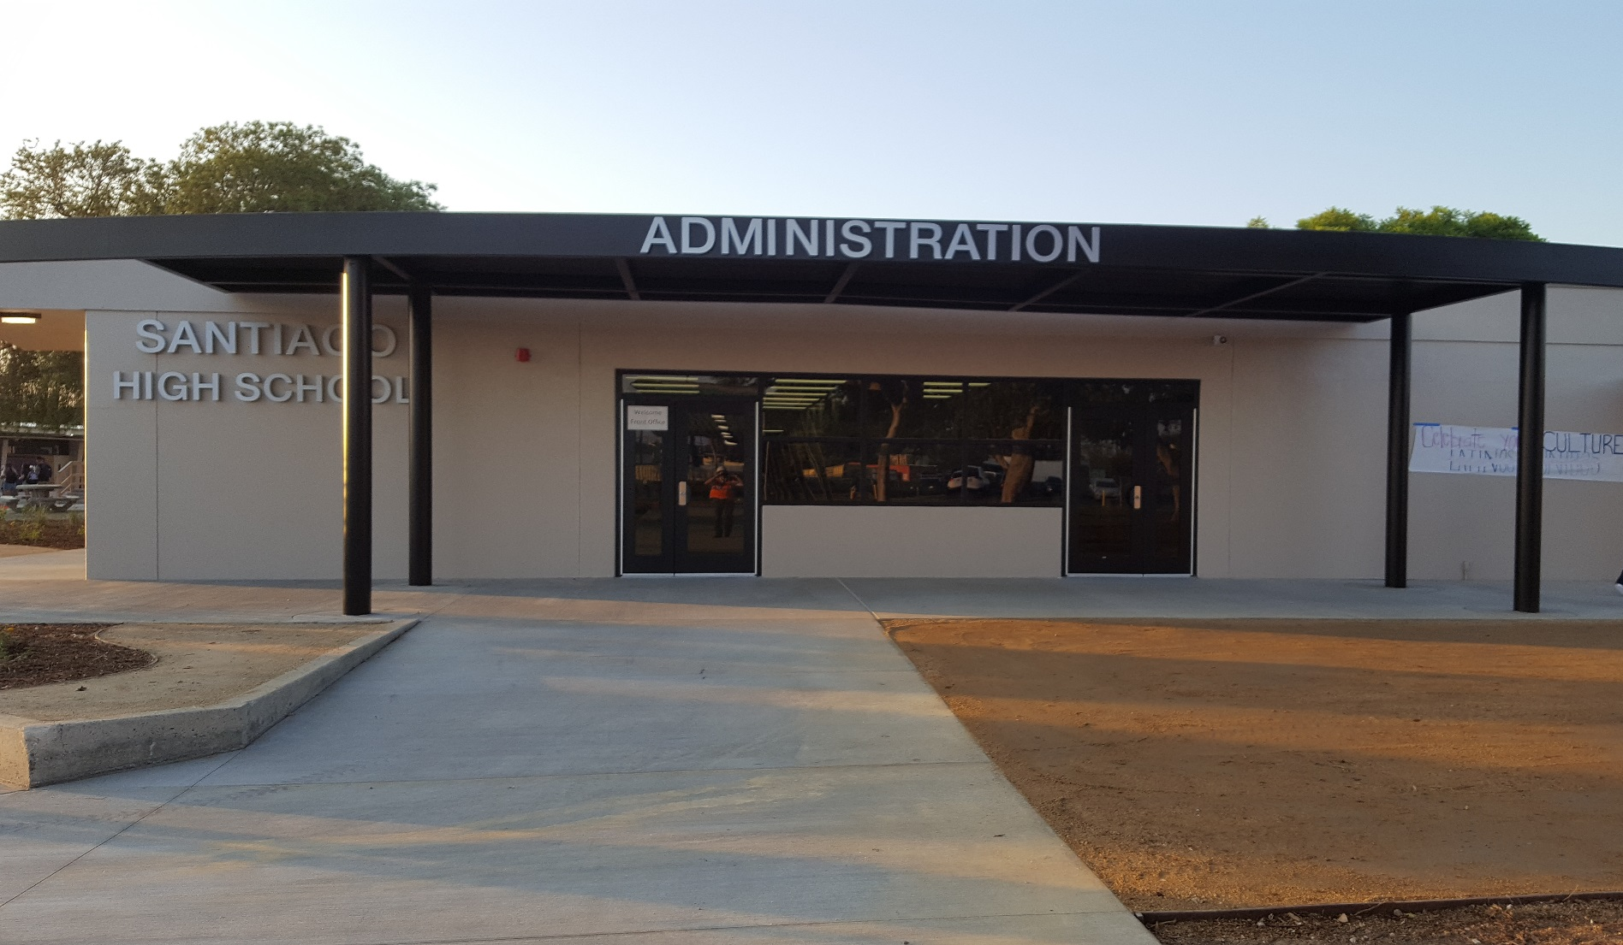
Modernization & HVAC
Santiago HS
Inviting school front with added efficiency measures

Slide 9

PACIFICA/LA QUINTA HIGH SCHOOL
Seismic Replacement
Buildings
Phase 1 CR Construction – Summer 2016
Move In / Exis. Building Demo – Summer 2017
Phase 2 CR & Cafeteria Const. – Winter 2017
Move In / Exis. Building Demo – Winter 2018
Theatre & Library Media – Winter 2018
Completion – Fall 2019
Measure

Slide 10
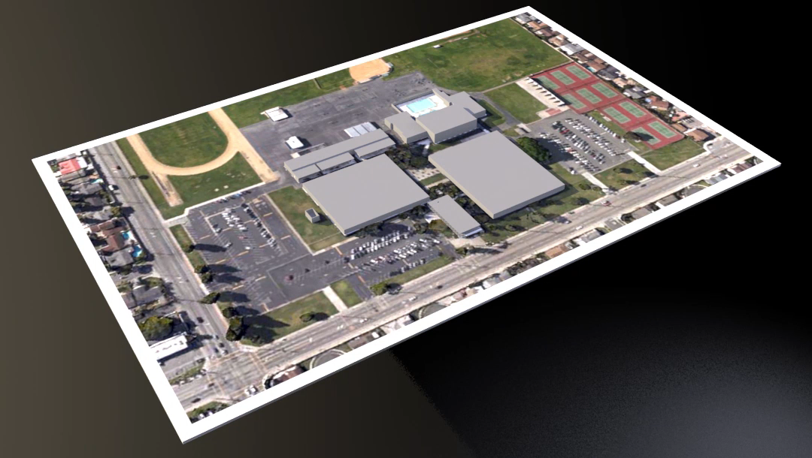
Measure
ANIMATION OF LA QUINTA

Slide 11
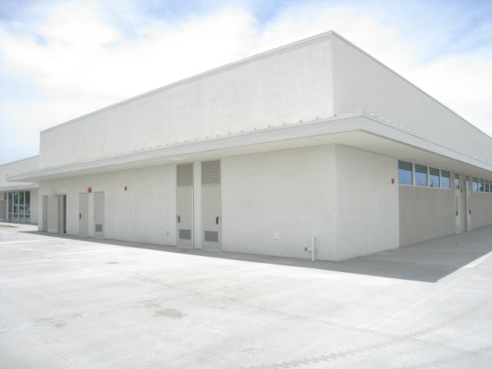
Seismic Replacement
Pacifica HS
Phase 1: New Classroom buildings occupied beginning 17-18 school year
Measure

Slide 12
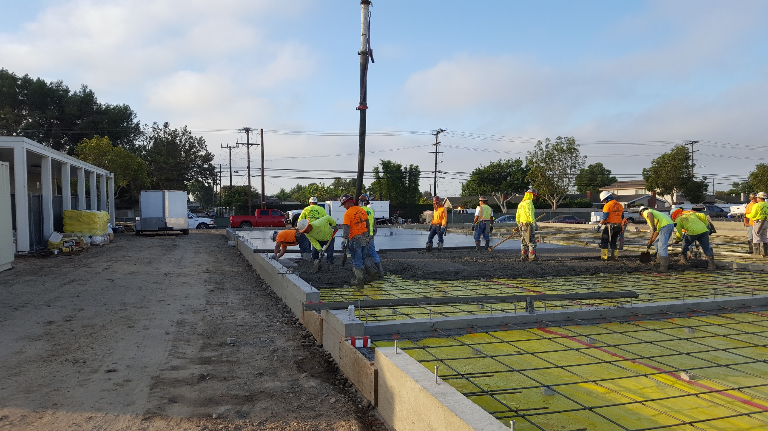
Seismic Replacement
Pacifica HS
Phase 2: concrete footings and building interior slabs
Measure

Slide 13
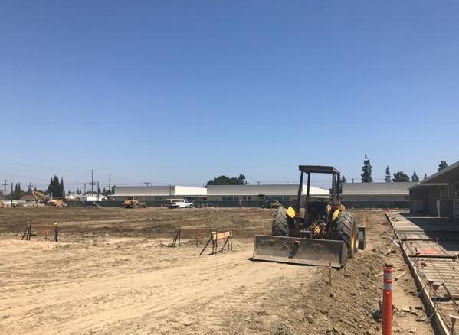
Seismic Replacement
La Quinta HS
Grading for Building Pads
Measure

Slide 14
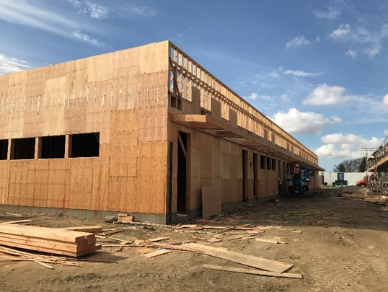
Seismic Replacement
La Quinta HS
Phase 2: New building exterior framing
Measure

Slide 15
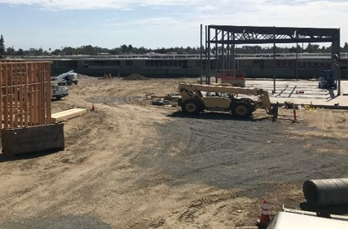
Seismic Replacement
La Quinta HS
Phase 2: New cafeteria steel framing
Measure

Slide 16
HVAC projects Summer 2017
  Hazard ES
  Heritage ES
  Rosita ES
  Wakeham ES
  Zeyen ES
Measure

Slide 17
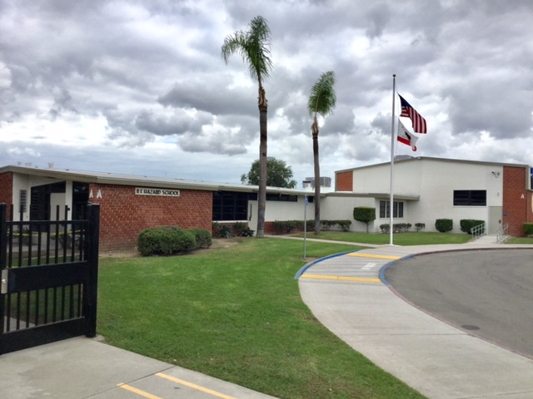
HVAC
Hazard ES
New ADA drop off, fencing for added security, flagpole, Windows and HVAC
Measure

Slide 18
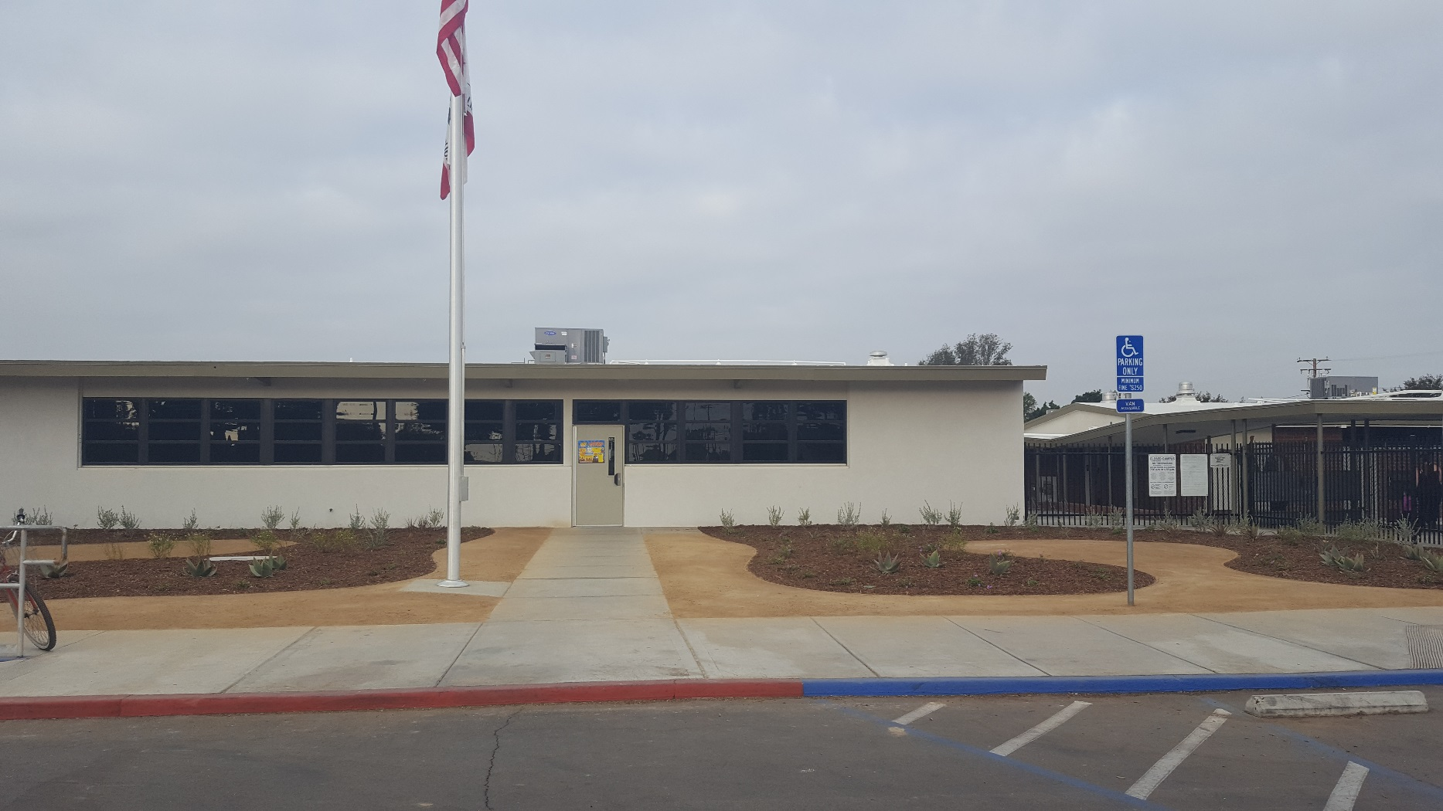
HVAC
Heritage ES
New windows, roofing, HVAC, flagpole, fencing, landscape, modern building finish
Measure

Slide 19
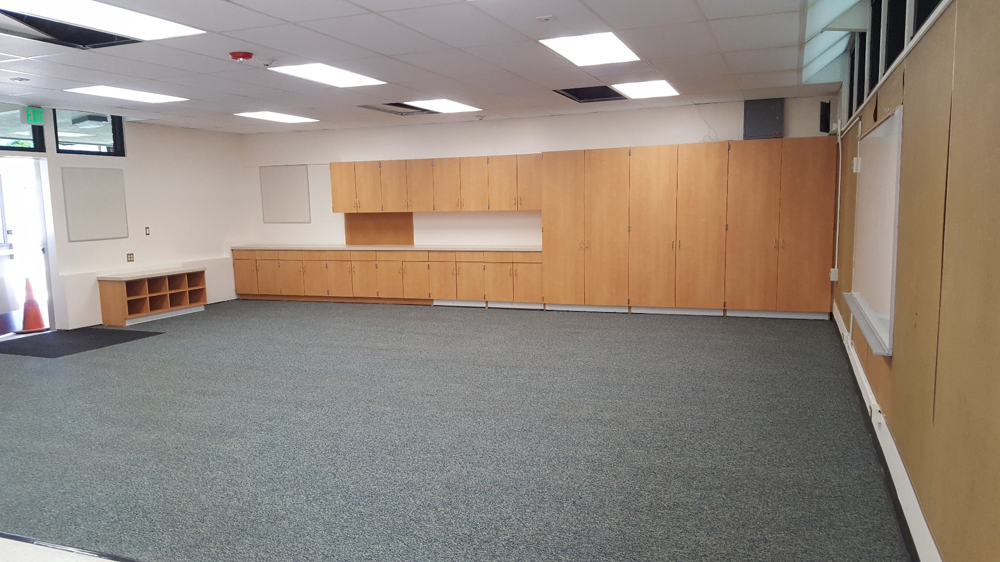
HVAC
Rosita ES
New Classroom Casework, Windows, Lighting, & Dropped Ceiling
Measure

Slide 20
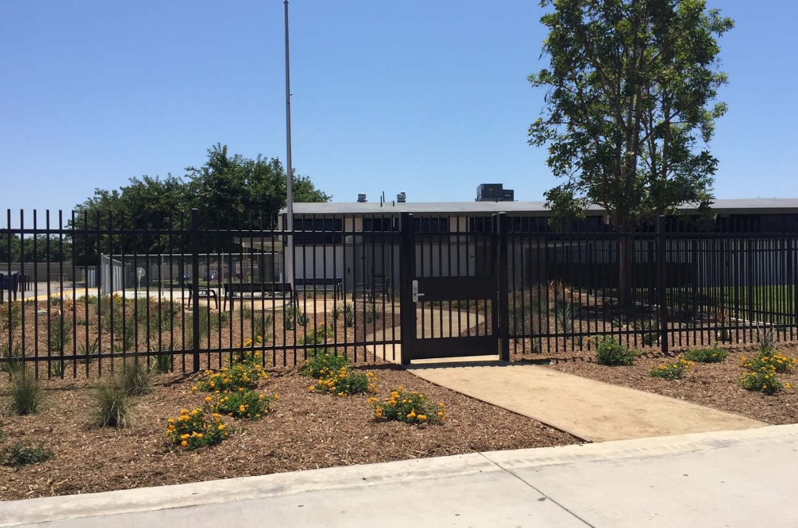
HVAC
Wakeham ES
New Office Location and Secure Entry
Measure

Slide 21
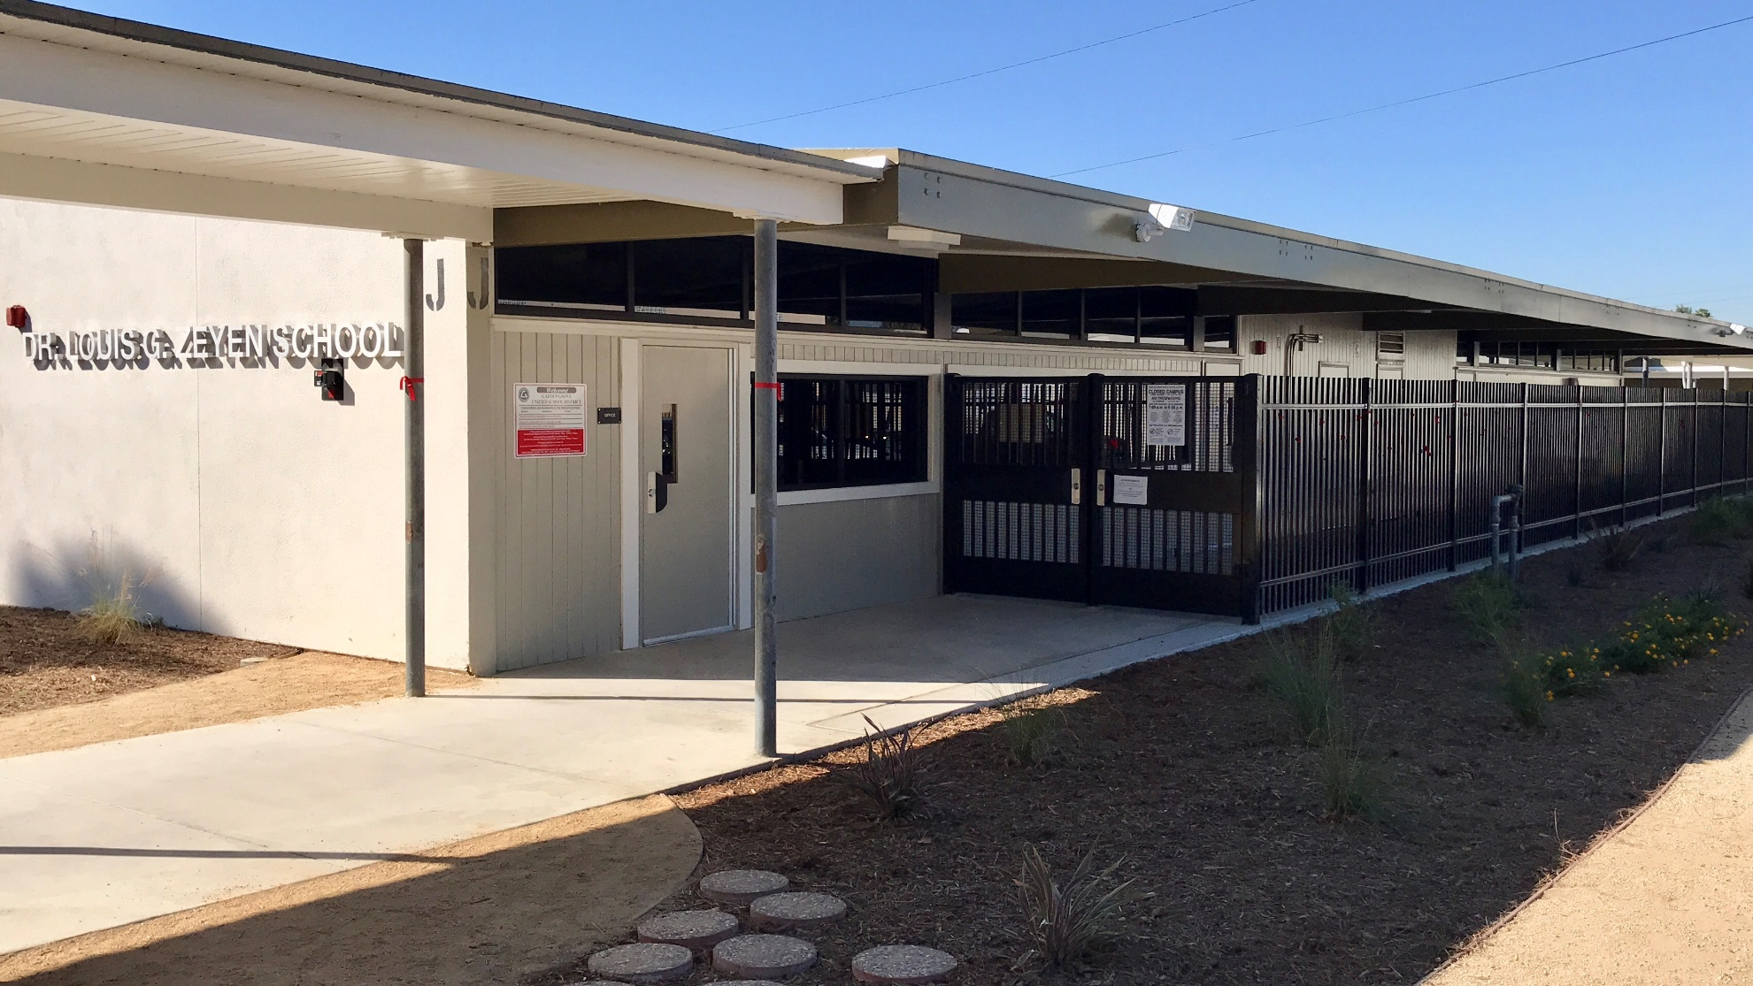
HVAC
Zeyen ES
New front entry and Secure campus entry
Measure

Slide 22
Athletic Improvements
Santiago Gym Floor & Bleacher
Santiago Pool Repairs
Measure

Slide 23
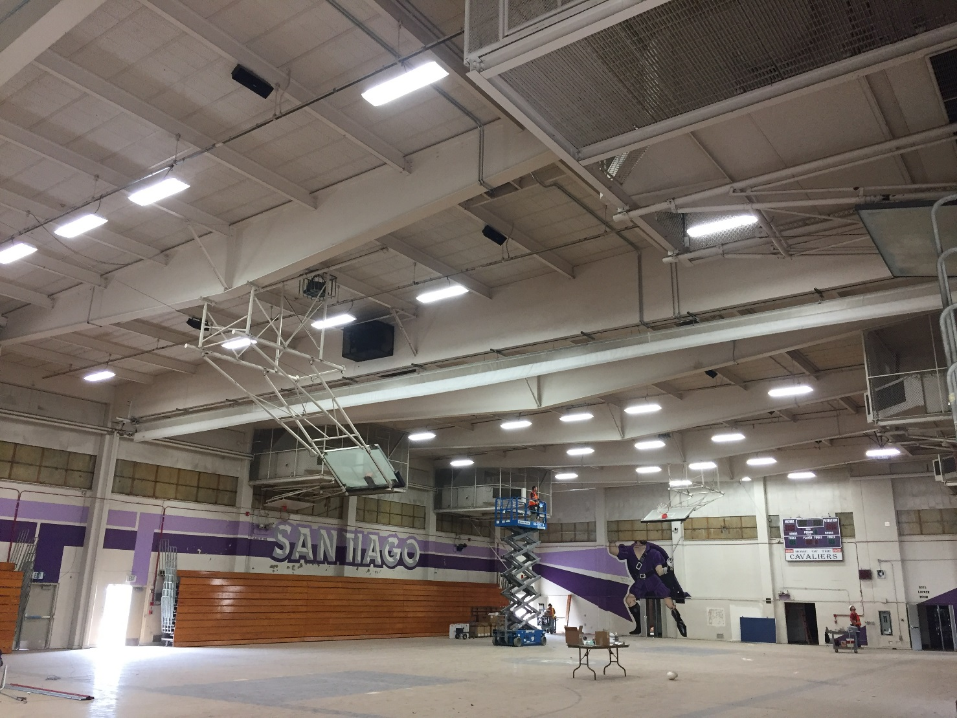
Gym Floor and Bleachers
Santiago HS
Before
Measure

Slide 24
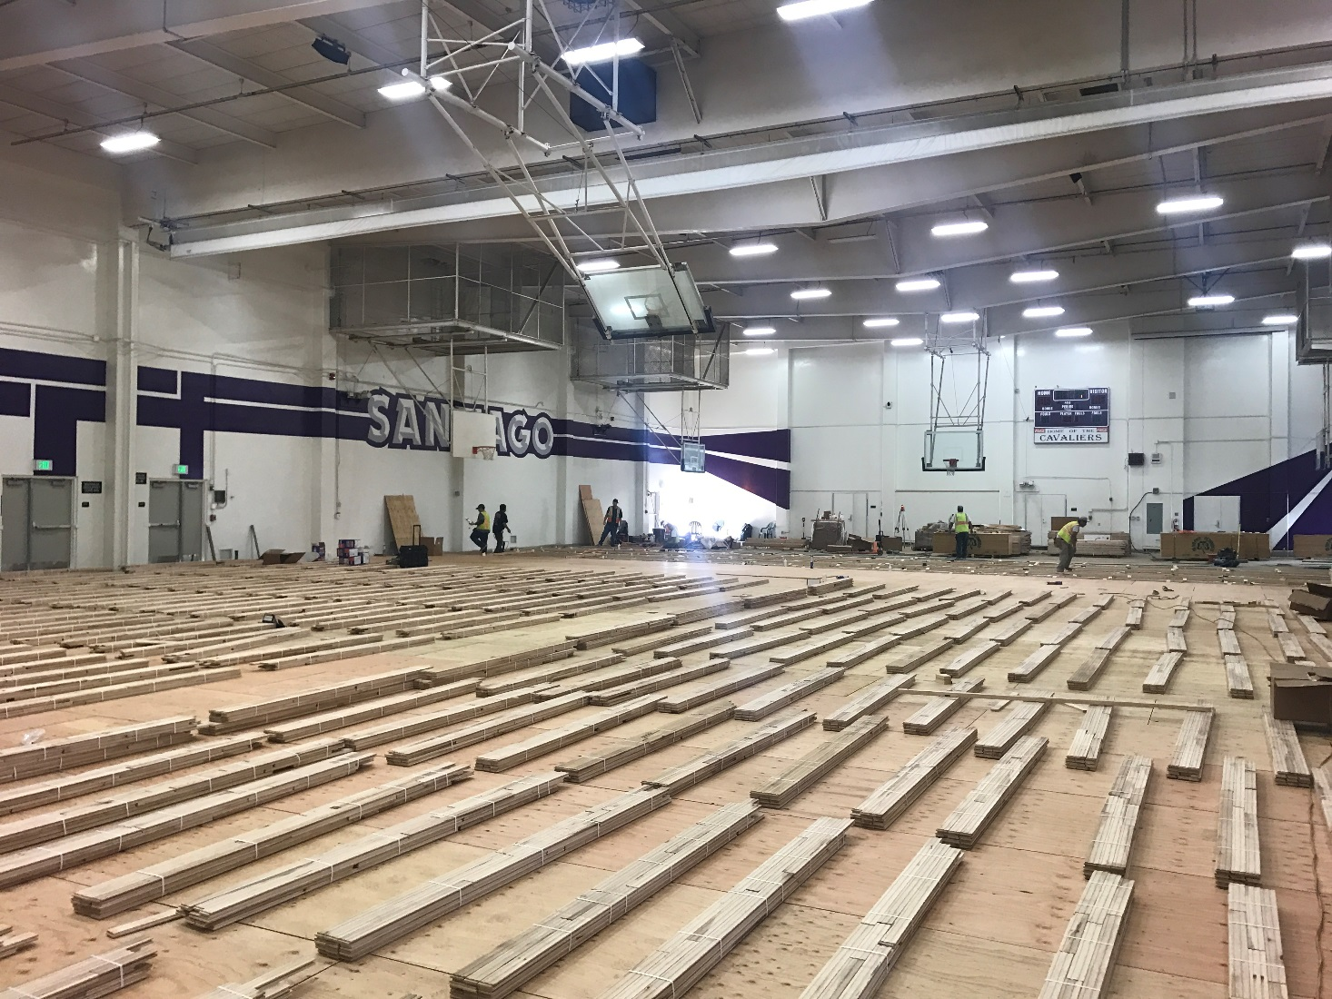
Gym Floor and Bleachers
Santiago HS
Sub floor in place, court surface staging
Measure

Slide 25
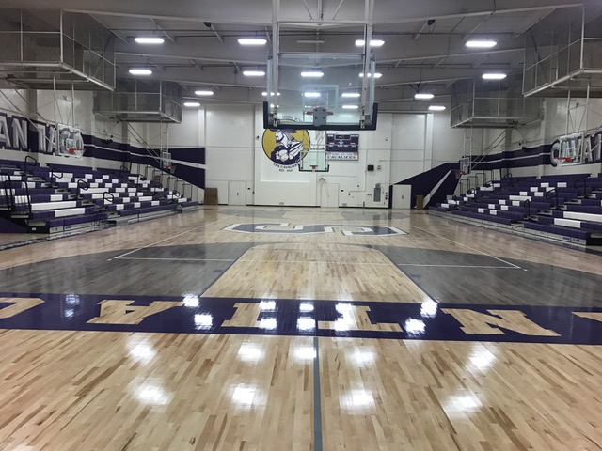
Gym Floor and Bleachers
Santiago HS
New Floor and Bleachers
Measure

Slide 26
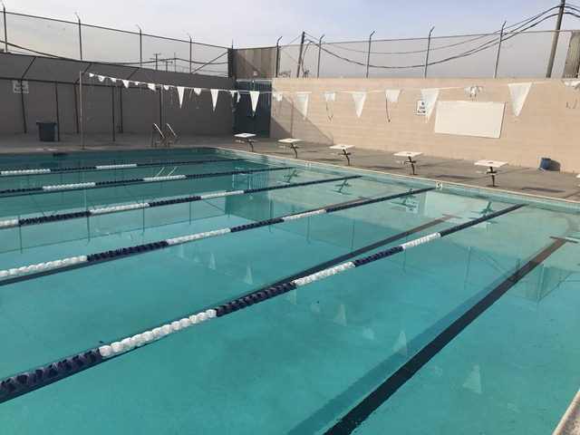
Pool
Santiago HS
New Pool Plaster, lighting, tiles and coping
Measure

Slide 27
Other projects in planning
HVAC projects 2018 and beyond
Bolsa Building R (Insurance claim)
Bolsa Stadium
Seismic Gym Locker Buildings & Pool
Measure

Slide 28
Other projects in planning
HVAC
  19 projects
  All plans have been submitted to DSA for approval
  To be completed over 3 Summers
  LLB negotiations to begin In October
  Anticipated Award Dec. 2017
Measure

Slide 29
Other projects in planning
Bolsa Building R (insurance claim)
  Reconstruction deemed futile effort
  New building to be constructed
  Plans DSA approved
  Proposals due late January
Measure

Slide 30
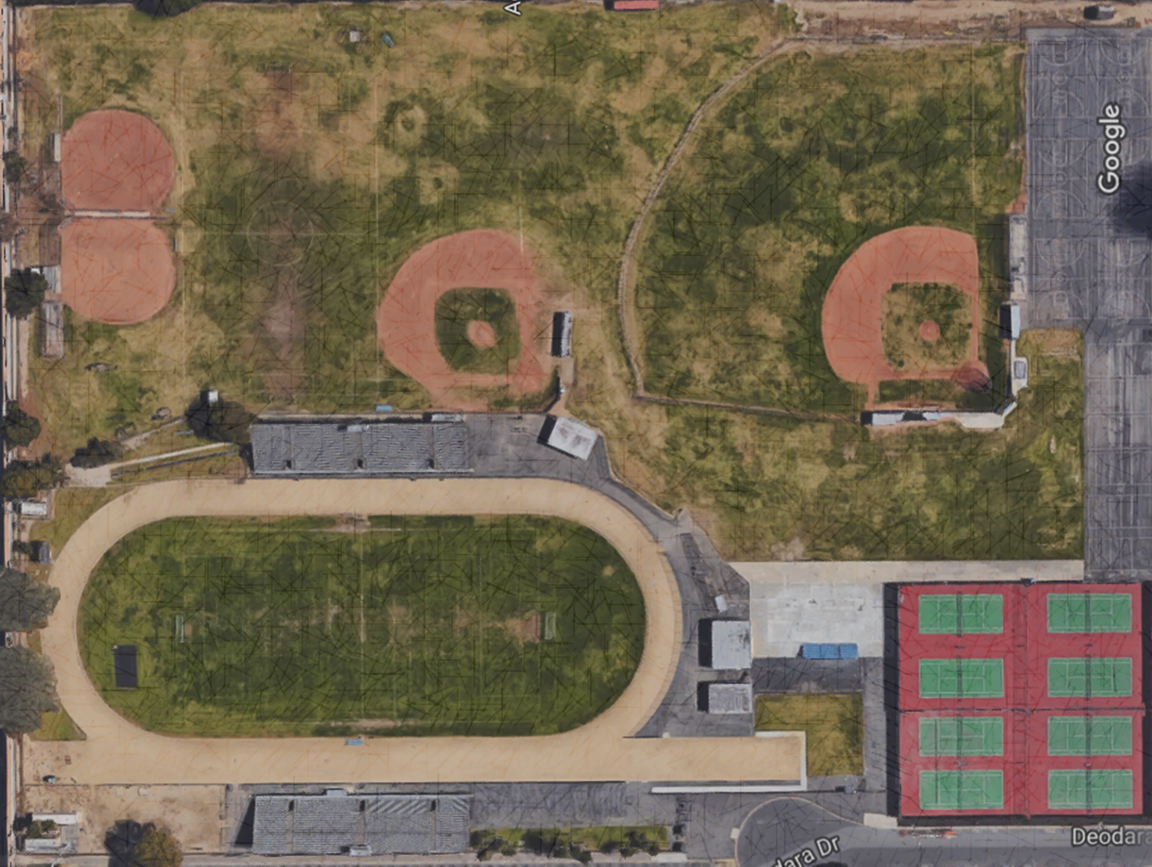
Other projects in planning
Bolsa Stadium
  Will be similar to Monsoor
  Currently in early planning stages
  Construction start: December 2018
Measure

Slide 31
Other projects in planning
Seismic Gym Locker Buildings
  Pacifica and LQ
  DSA Approved in September
  Funding applications in process for up to 50% match
  Gymnasium, Locker Rooms, Pool
Measure

Slide 32
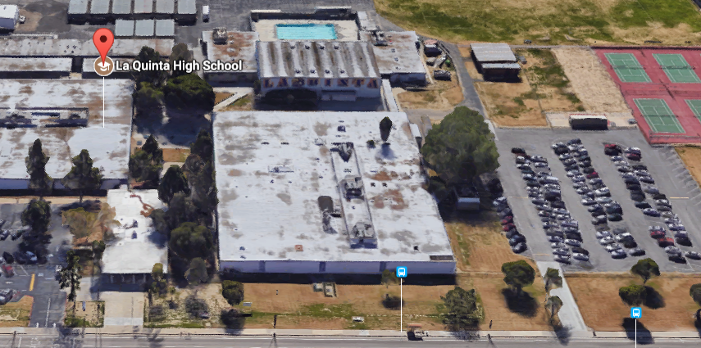
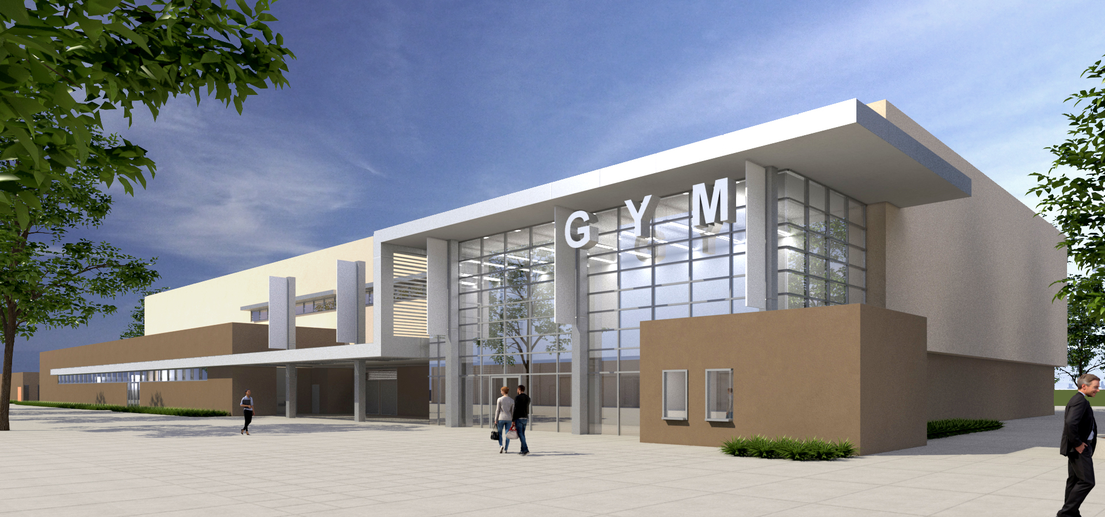
La Quinta HS
Measure

Slide 33
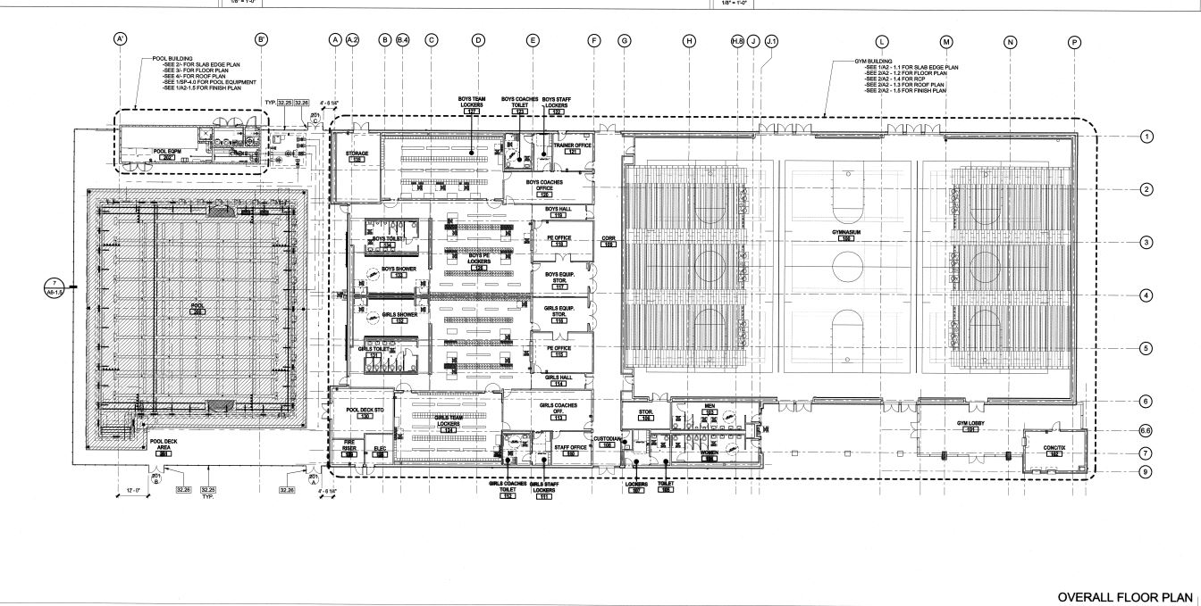
La Quinta HS
Measure

Slide 34
La Quinta HS
Measure

Slide 35
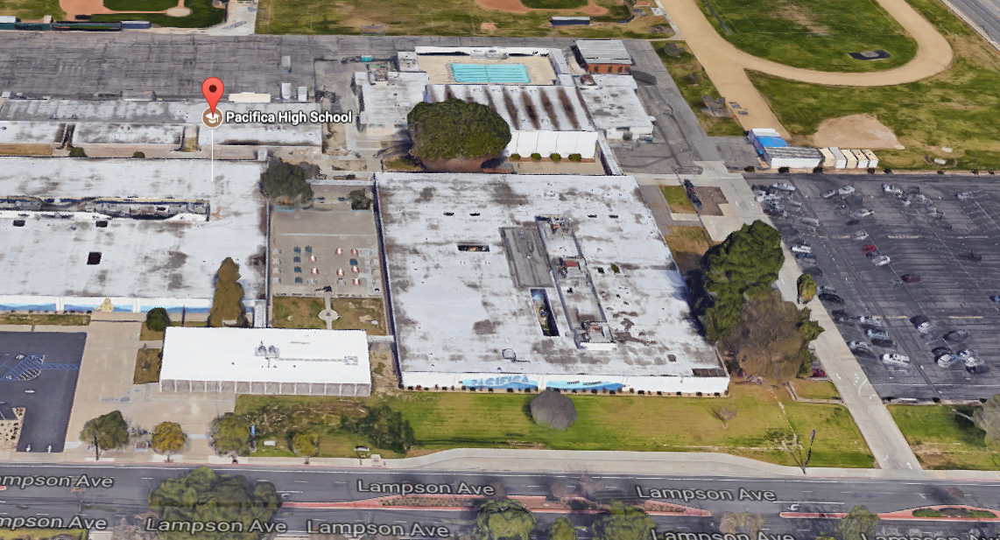
Pacifica HS
Measure

Slide 36
QUESTIONS

Slide 37
Facilities Update
Thank You!

